Slide 1

Project: TA Report Web App
IE04 Weekly Progress Report, Phase Demo 2
2023/01/10
Team: Pikachu

Slide 2
Activities of Previous Week
Task | Member | Work Hours
(API Integration) login screen | Youssef | 5:30
(API Integration) TA course screen | Merci | 9:30
(API Integration) TA report screen | Merci | 8:30
(front-end) faculty screens | Youssef | 5:30
(front-end) admin screens | Youssef | 3:30
 | Total time: | 57h:00

Slide 3
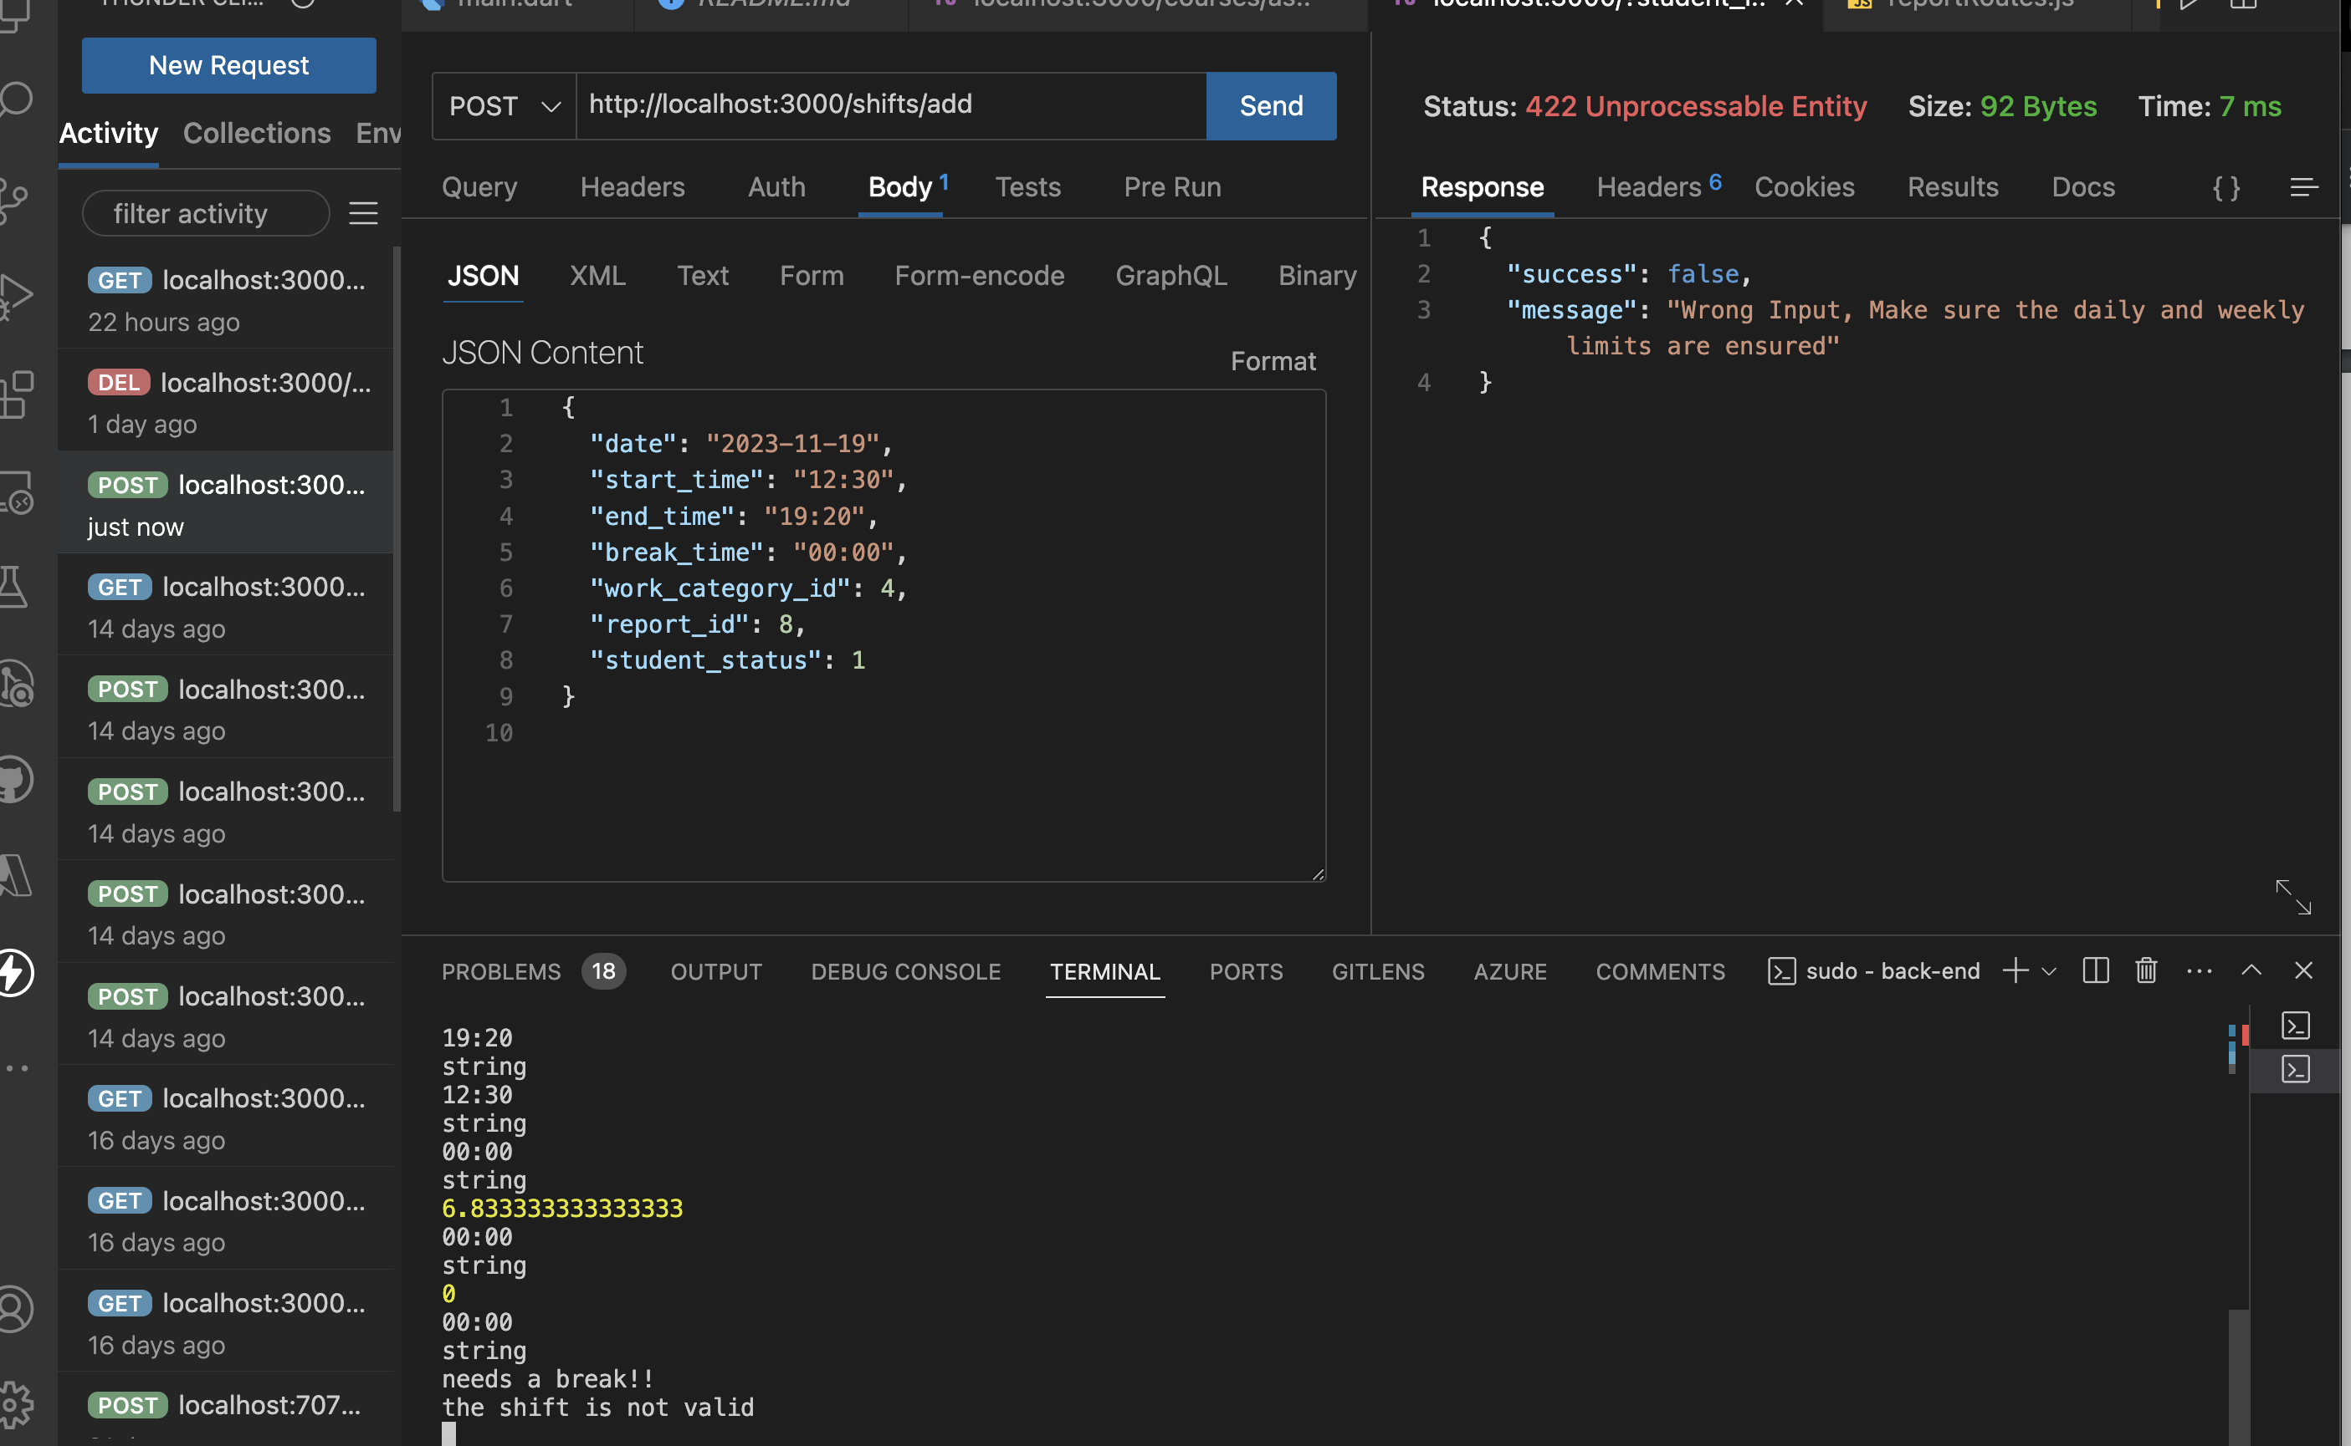
API

Slide 4
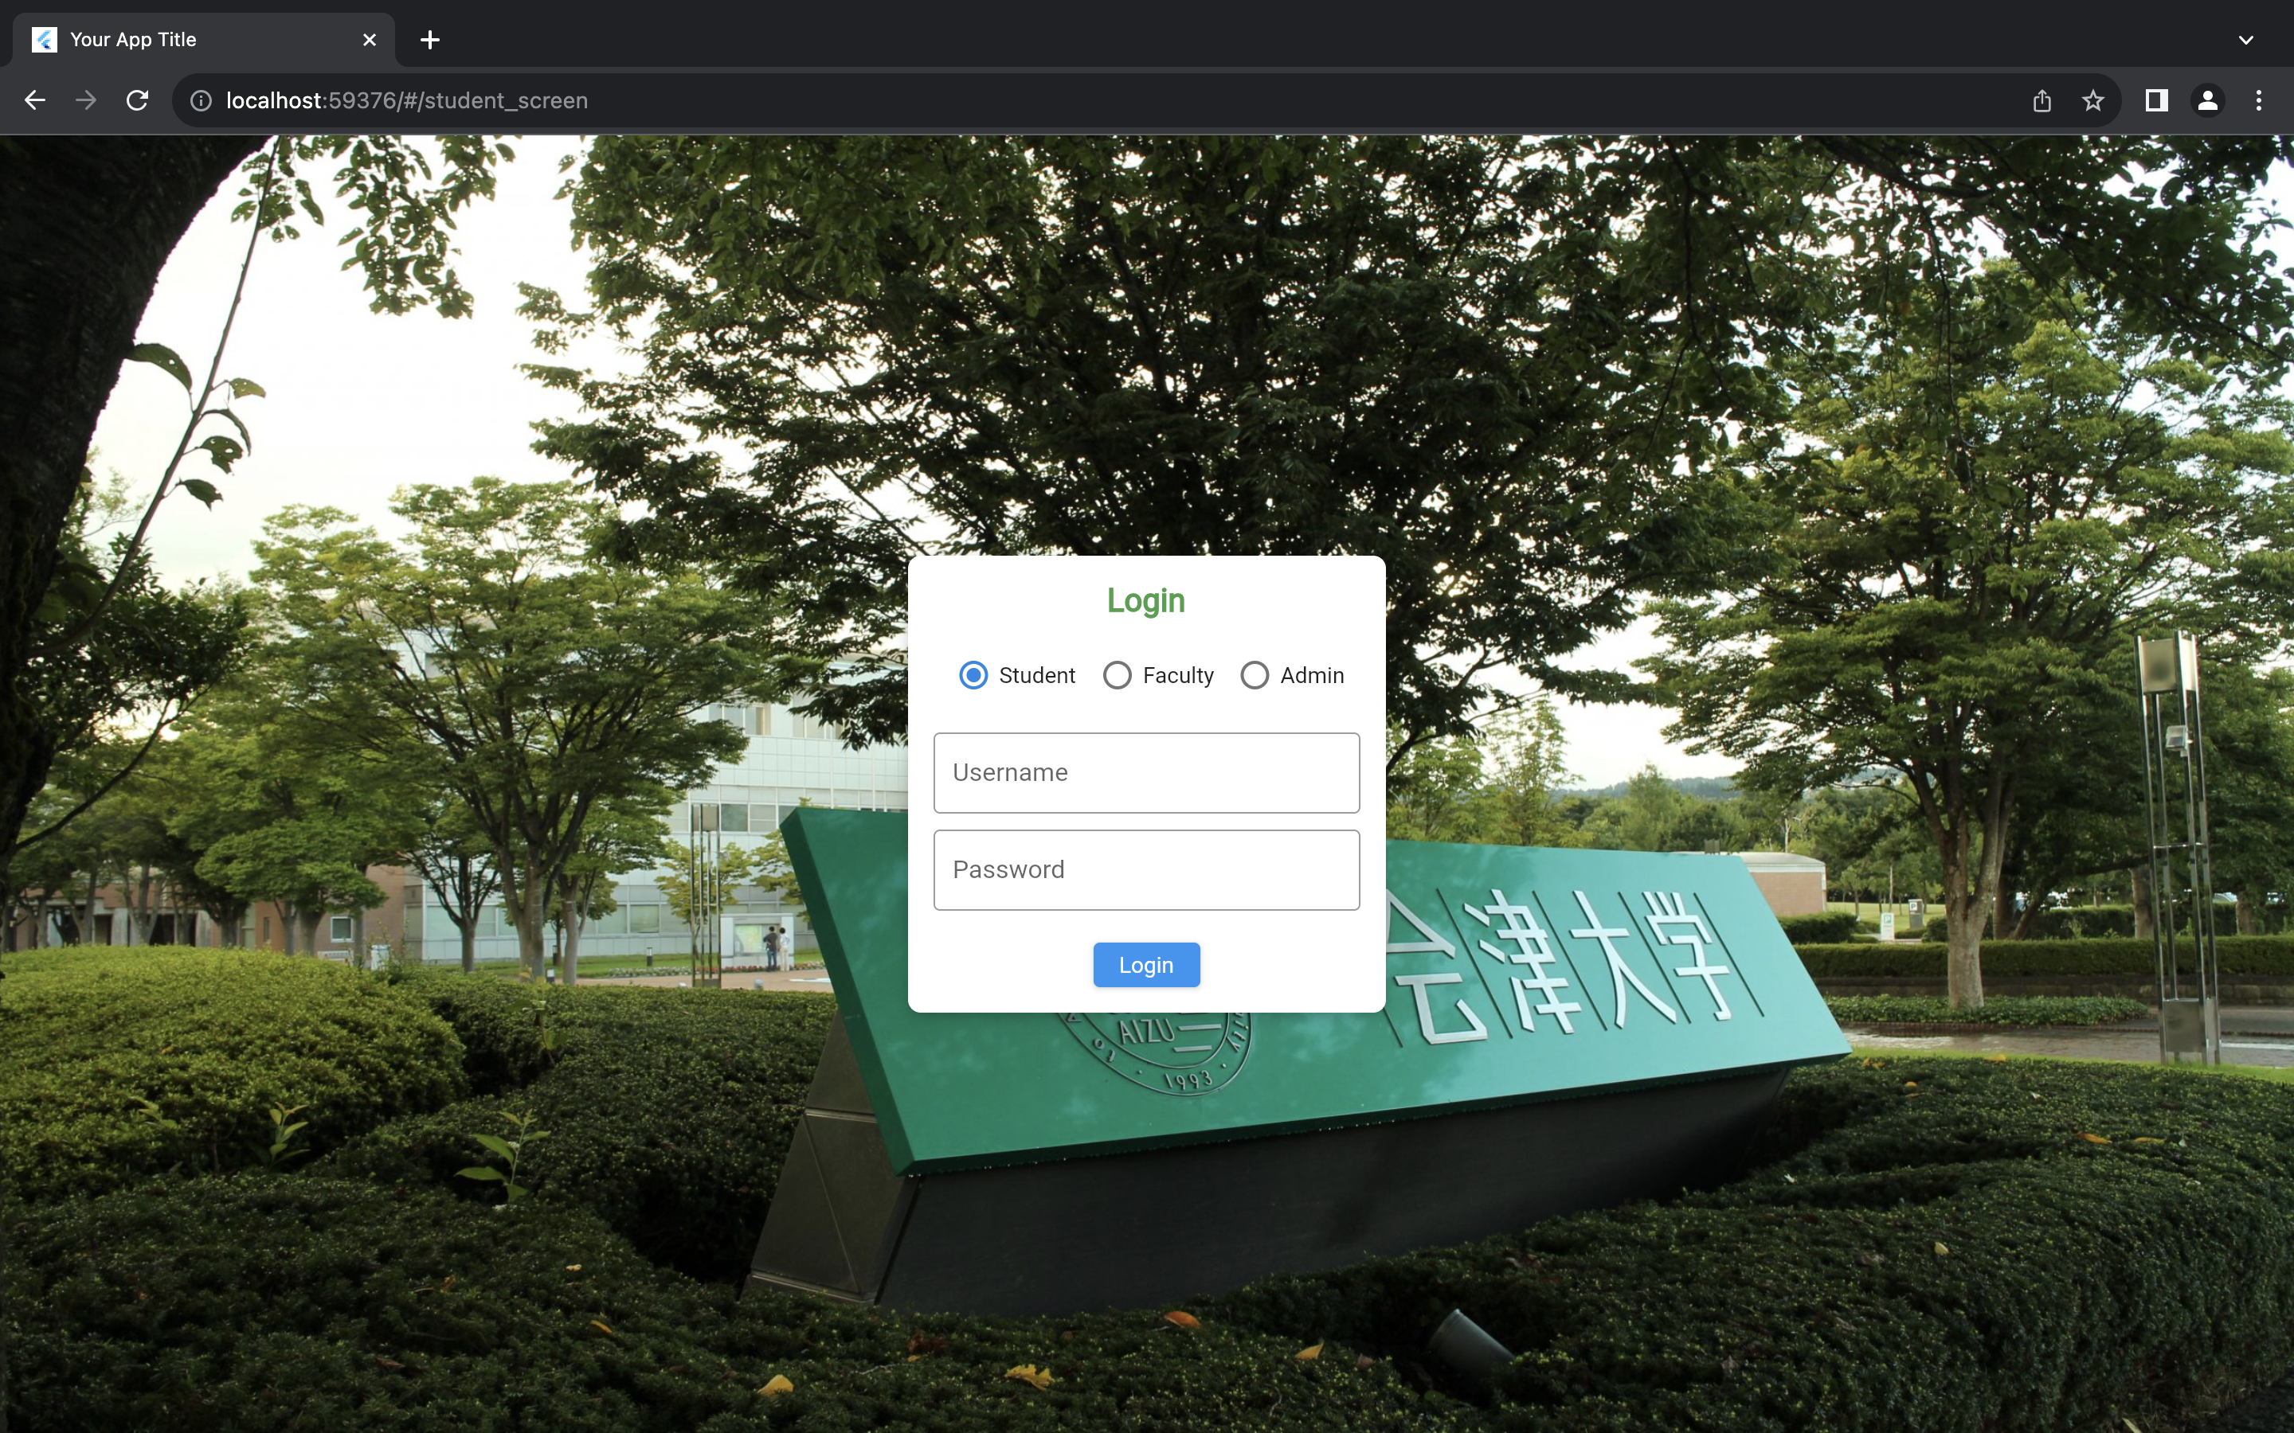
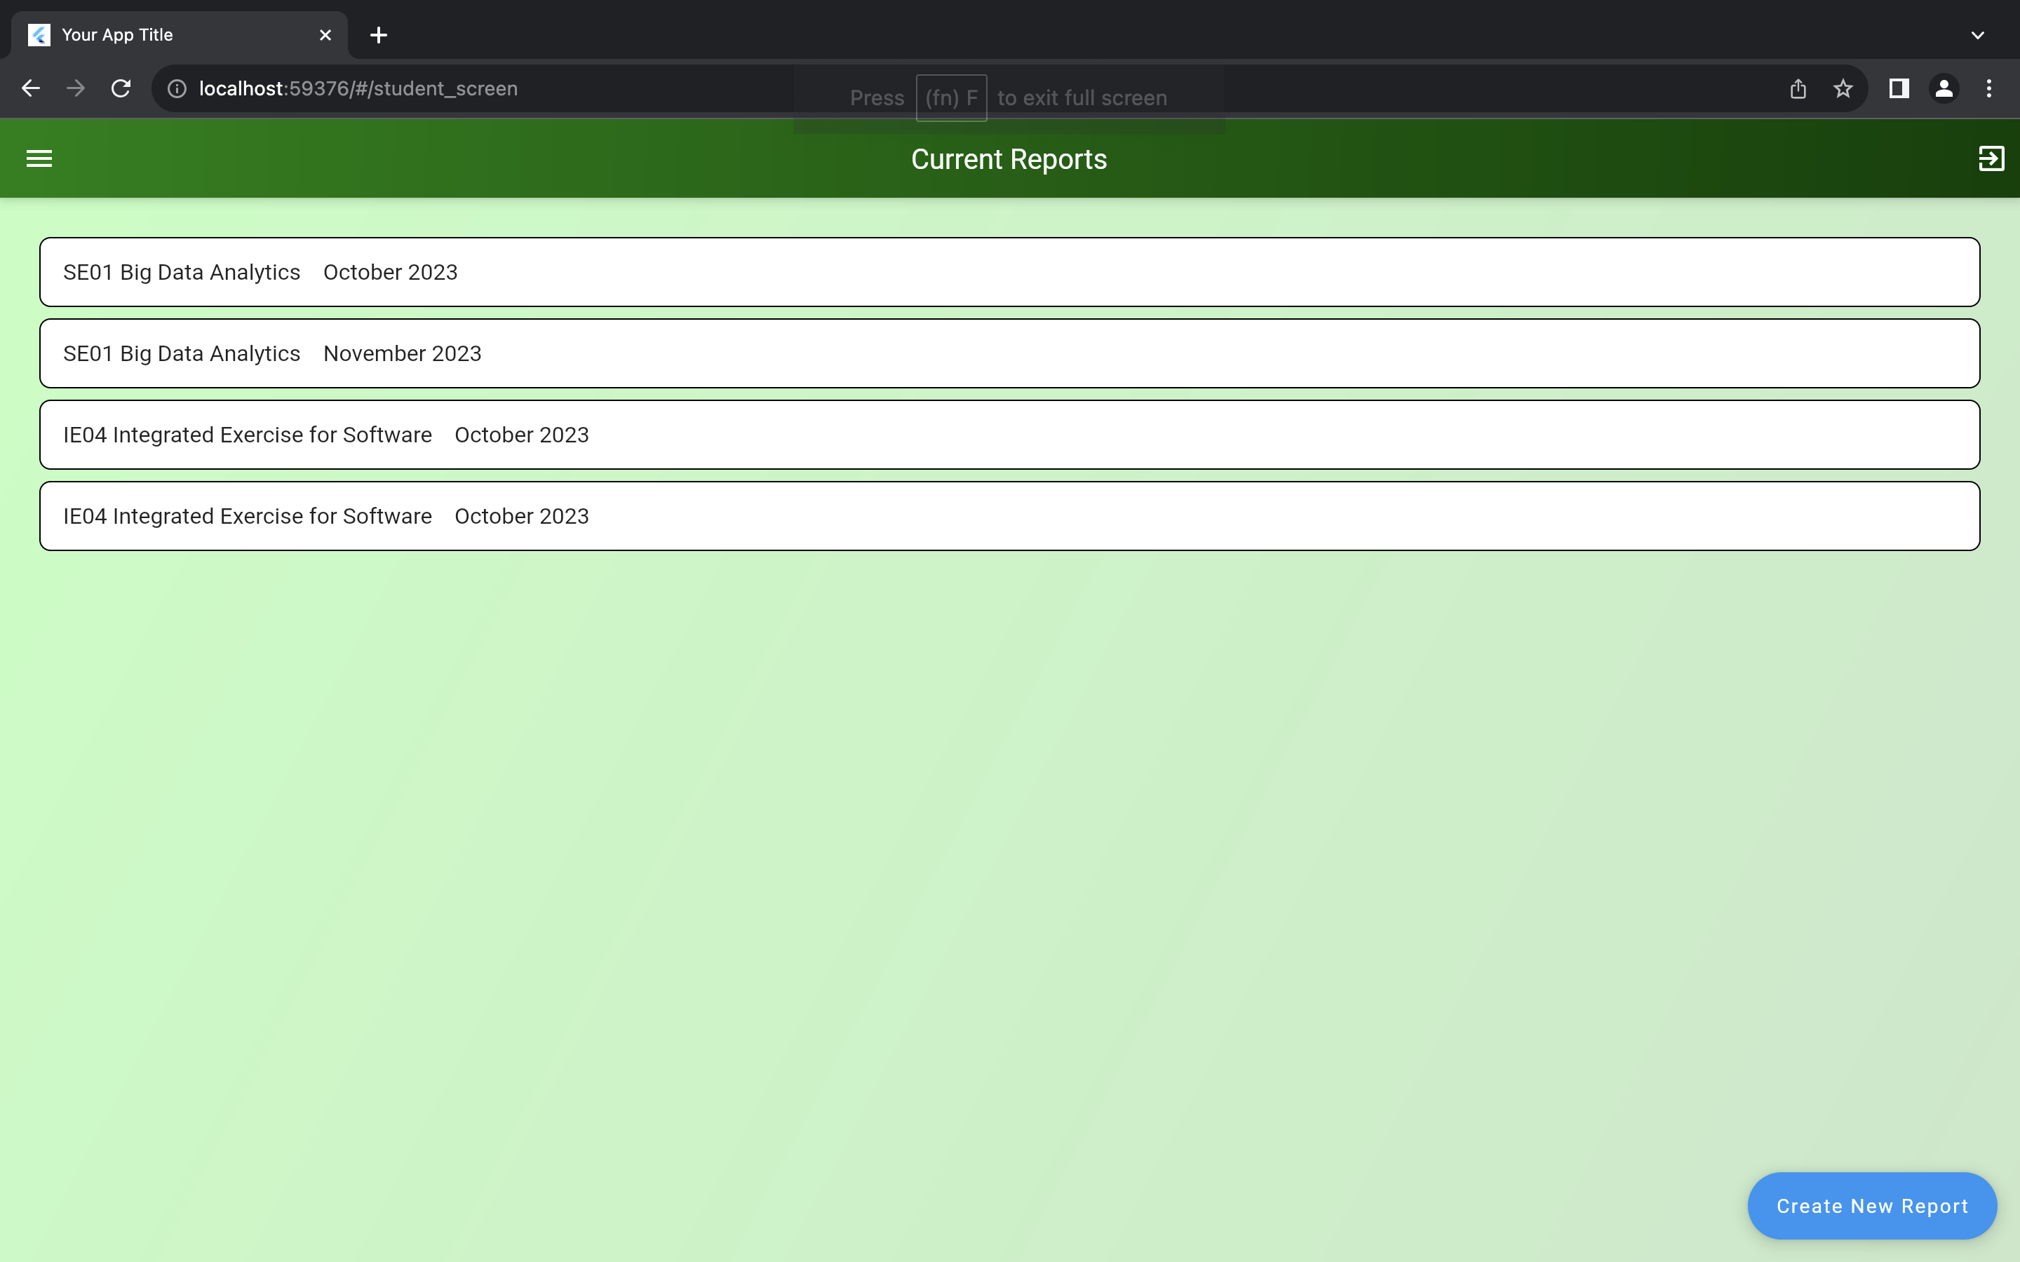
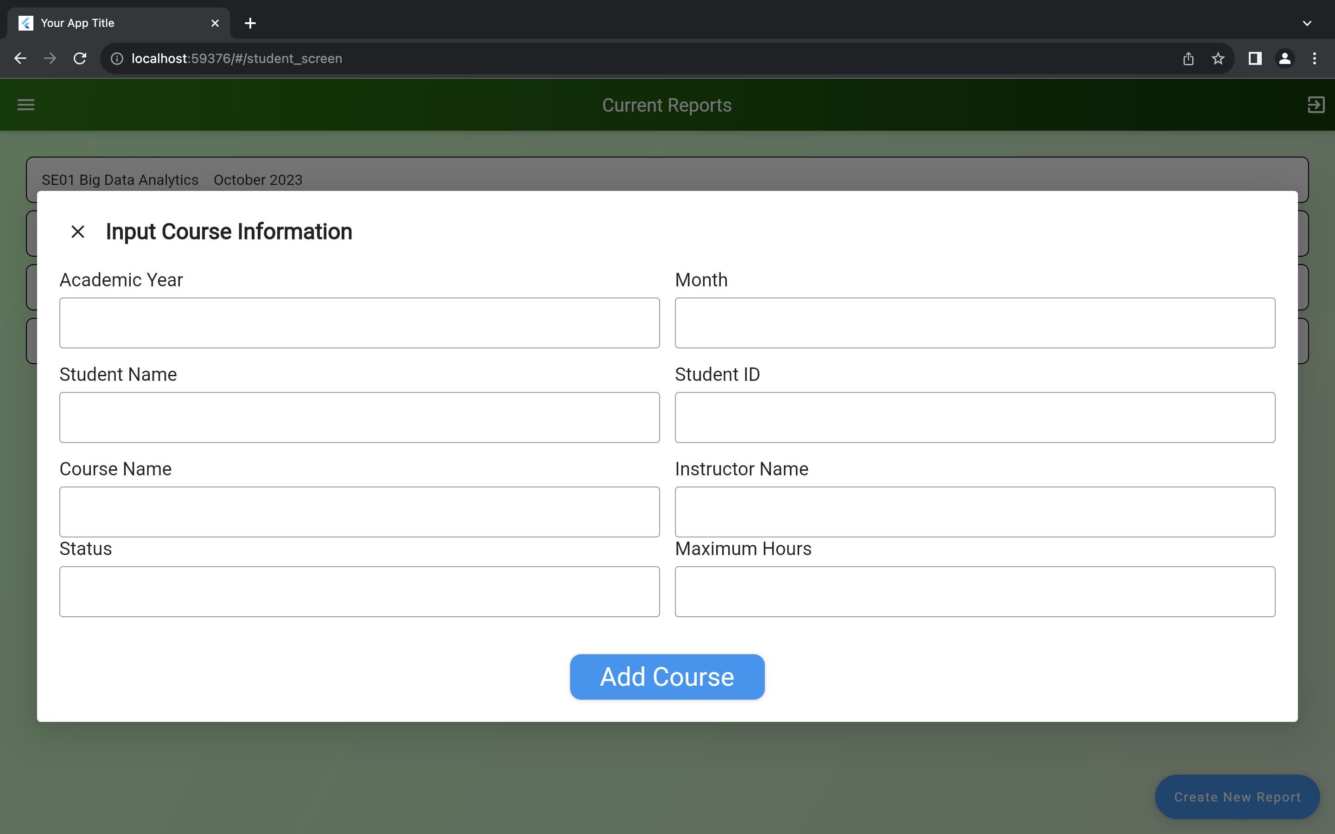
Front-End

Slide 5
Plan for Next Week
Task | Member | Work Hours
(Front-end& back-end) API connect (Wednesday) | Youssef & Merci | 2:30
(back-end) API modification (start from Saturday) | Merci | 8:00
(Front-end) API Integration for admin/faculty screens (start from Saturday) | Youssef | 8:30
 | Total time: | 16h:00

Slide 6
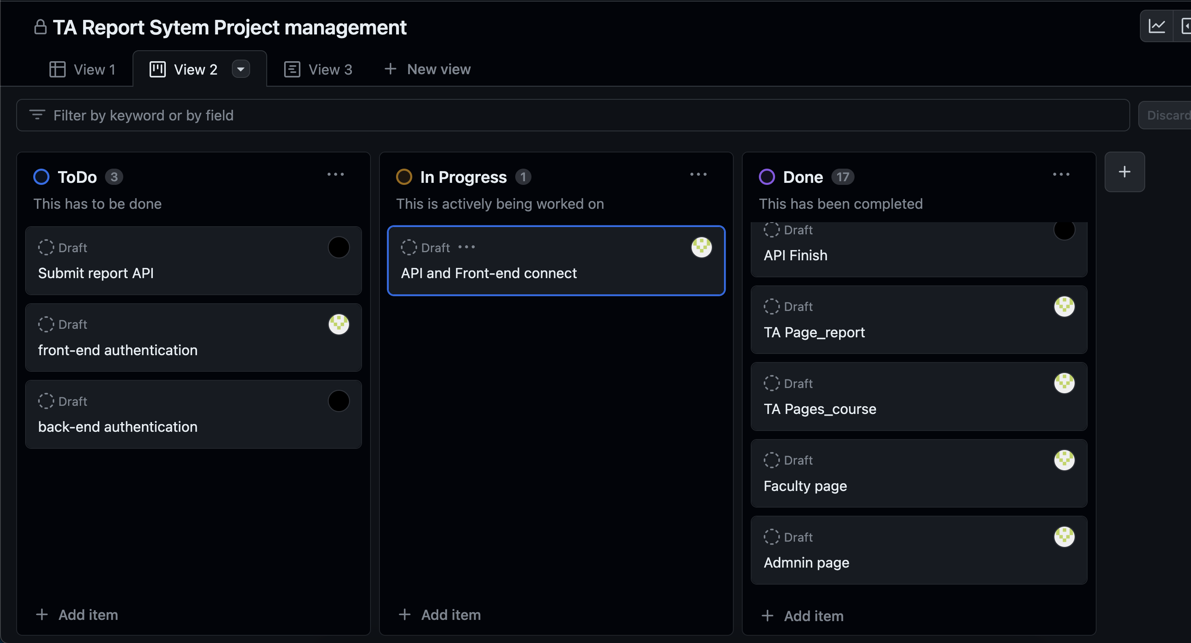
Phase Task Board

Slide 7
Issues & Risks (*if any)
Problem: API errors, still implementing thorough connections
Cause: Unchecked Bugs
Possible Solution: do all checks for negative and wrong inputs
Deadline: Jan 25, 2024

Slide 8

Thank you

